Slide 1
Opposition to AT&T Cell Tower Request
CU 2020-02 & VAR 2020-07

Slide 2
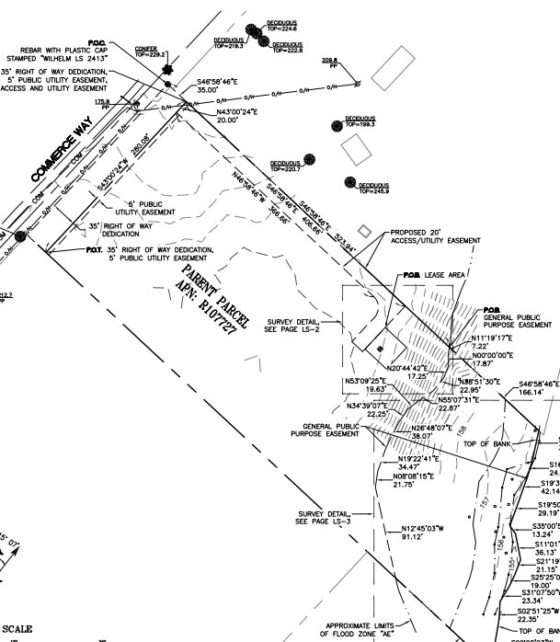
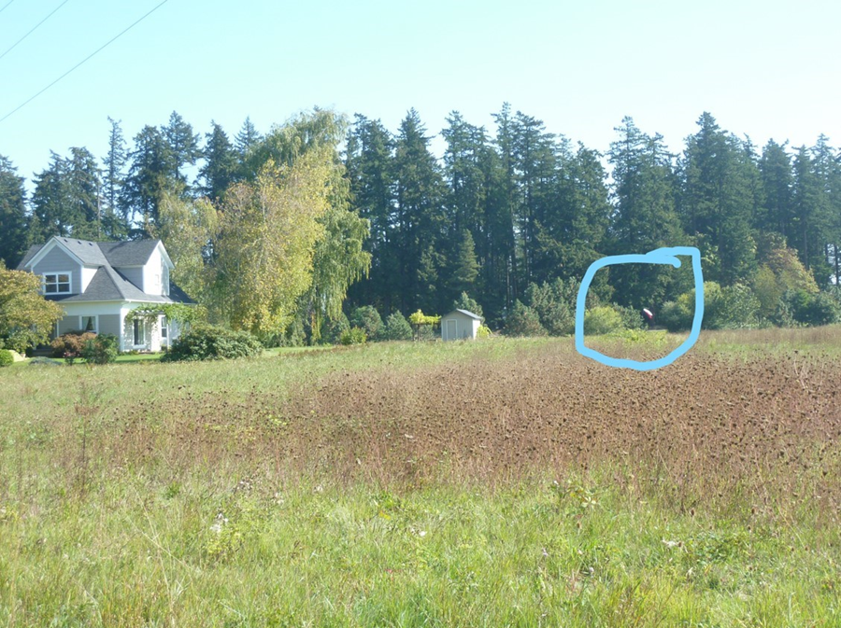
“The proposed use must be compatible with surrounding properties” considering the aesthetic impact on the “living environment” – WDC 5.03.01

Slide 3
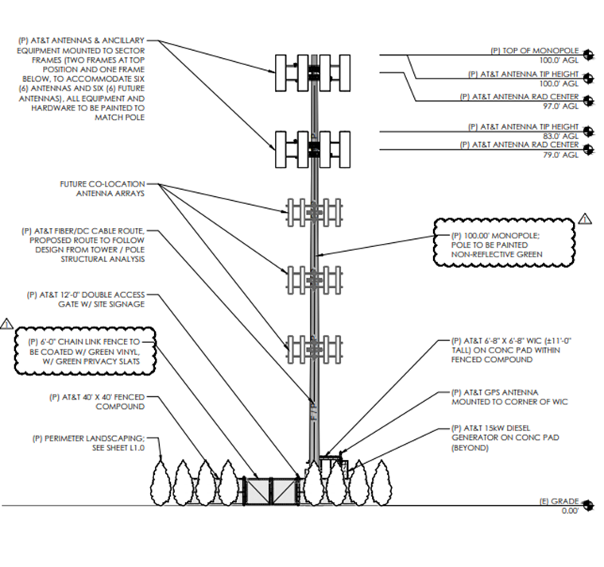
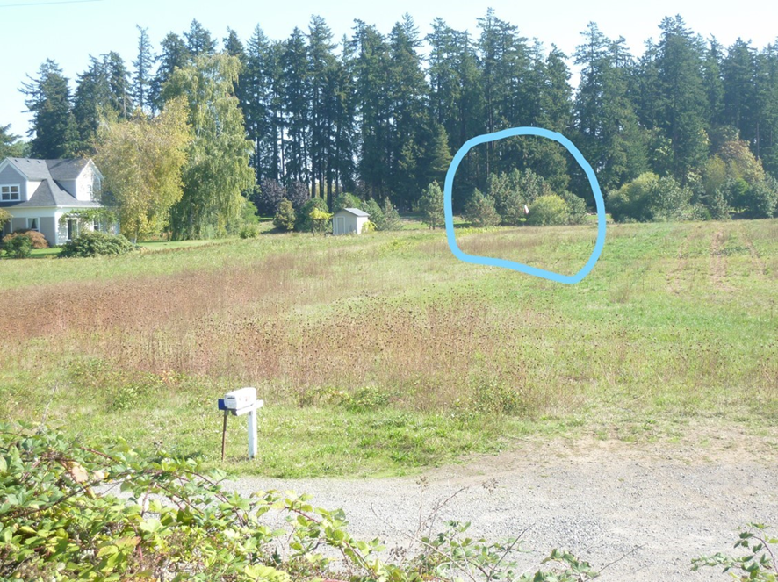
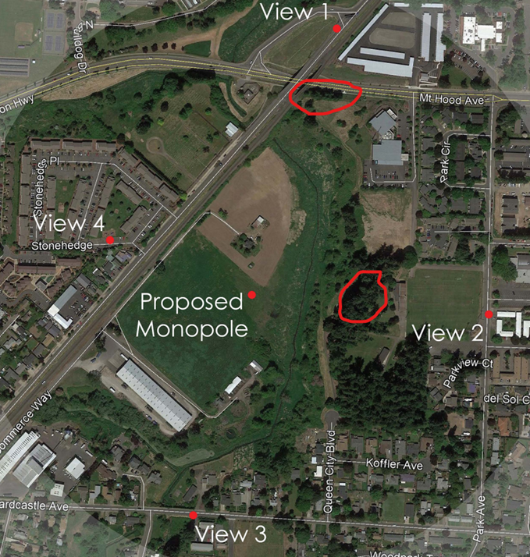
Green paint and vegetation screening will not mitigate for this massive tower that will loom over the Simeonov residence.

Slide 4
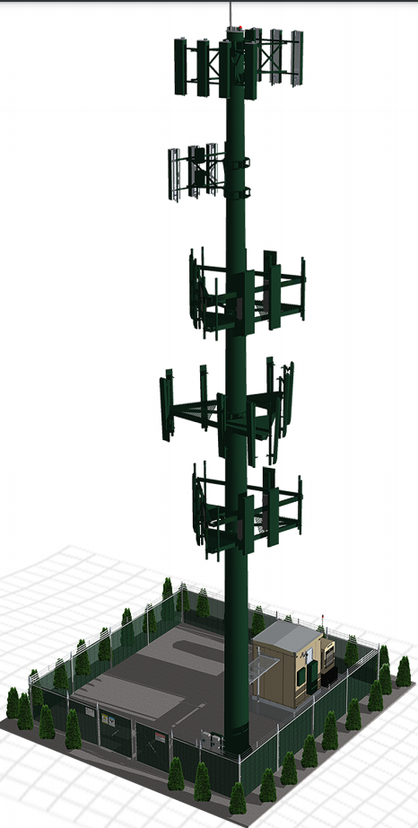
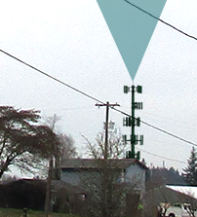
Tower must have the “smallest practicable visual impact on the environment.” WDC 2.08.03(5)

Slide 5
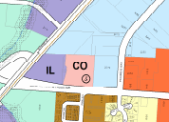
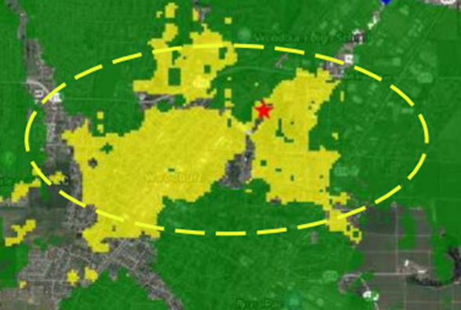
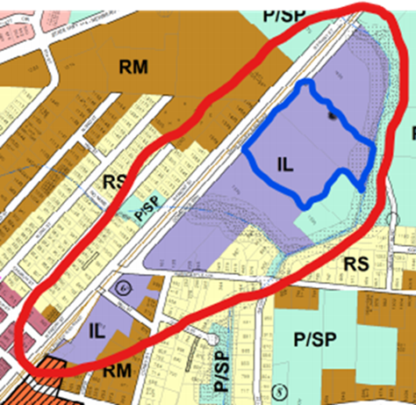
Many other locations are “practicable” and would have less visual impact.

Slide 6
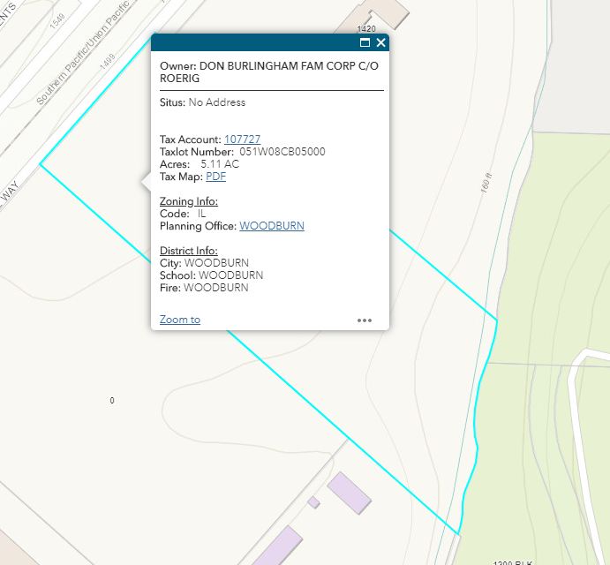
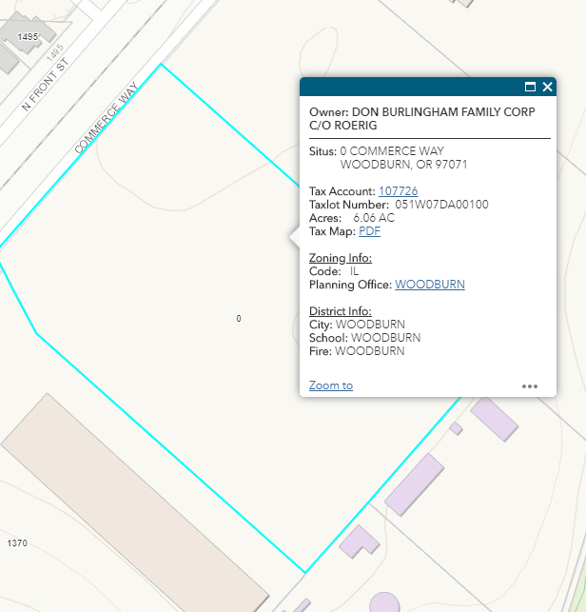
Visual impact could also be reduced by moving the tower to the southern edge of the “parcel.”

Slide 7
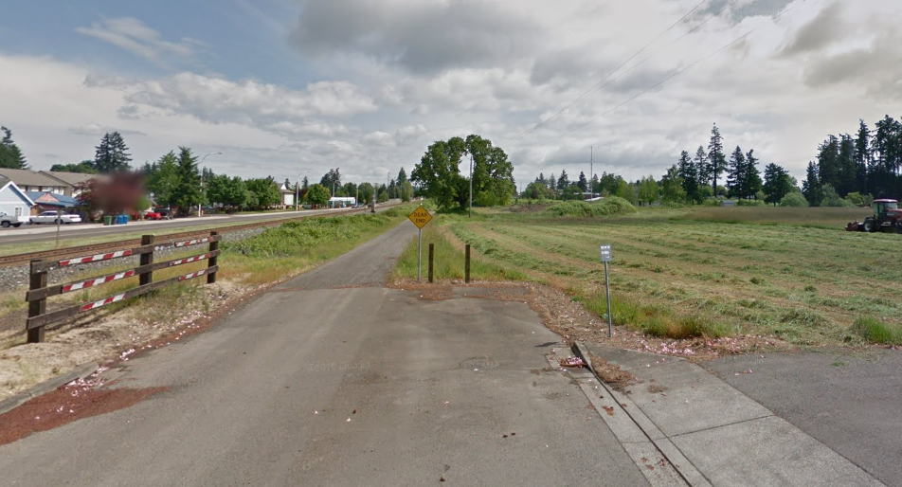
Commerce Way – No improvements proposed – Variance requested

Slide 8
Would compliance with the standards impose an “excessive burden” on the owner or would granting the variance “unreasonably impact” adjacent owners?” WDC 5.03.12.B
- Traffic generated to construct the tower will significantly exceed one trip per month and will substantially compromise the road condition.
- Even once a month use by a heavy maintenance vehicle on a gravel surface will increase the impact and expedite road degradation.
- The applicant does not propose to contribute to road maintenance or other mitigation leaving the Simeonovs to make these improvements alone.

Slide 9
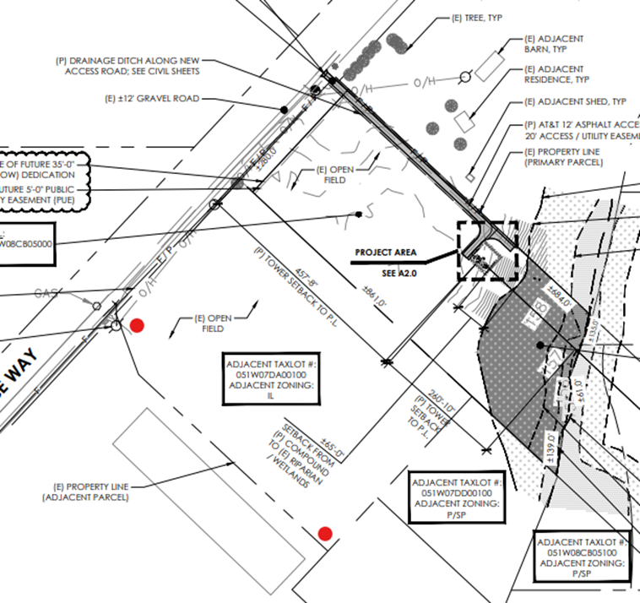
The variance criteria include factors that the Planning Commission must use to balance competing interests including the extent to which the applicant is responsible for or could mitigate the hardship triggering the variance. WDC 5.03.12.B.

Slide 10
The criteria for granting a conditional use permit or a variance are not satisfied. Therefore, please deny these applications.
Thank you for your thoughtful consideration of this request.

